Slide 1
Python Programming
Session 2: (Loops with Practical Application)

Slide 2
Agenda:
1 | For Loops and While Loops
2 | Large Practical Application

Slide 3
For Loops and While Loops

Slide 4
For Loops and While Loops
Loops are fundamental control flow structures in Python that allow you to execute a block of code multiple times. This session will cover the for loop and while loop, which are used for iterating over sequences and executing code as long as a condition is true, respectively. Understanding these loops is crucial for handling repetitive tasks efficiently in programming.

Slide 5
For Loops
A for loop is used to iterate over a sequence (such as a list, tuple, string, or range) and execute a block of code for each item in the sequence.

Slide 6
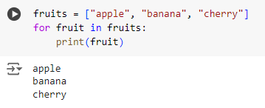
For Loops
Examples
Iterating Over a List
This loop iterates over each item in the fruits list and prints it.

Slide 7
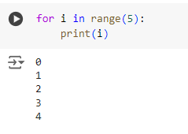
For Loops
Examples
Iterating Over a Range of Numbers
The range(5) function generates numbers from 0 to 4. The loop prints each number.

Slide 8
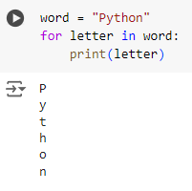
For Loops
Examples
Iterating Over a String
This loop goes through each character in the string "Python" and prints it one by one.

Slide 9
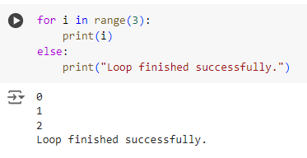
For Loops
Examples
Using a For Loop with an Else Clause
The loop prints numbers 0 to 2, and after the loop completes, the else clause executes

Slide 10
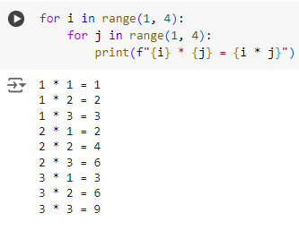
For Loops
Examples
Nested For Loop (Multiplication Table)
This nested loop generates a multiplication table for numbers 1 to 3.

Slide 11
While Loops
A while loop repeatedly executes a block of code as long as a specified condition remains true. It is often used when the number of iterations is not known beforehand.

Slide 12
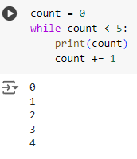
While Loops
Examples
Basic While Loop
This loop prints the value of count and increments it by 1 each time. It stops when count reaches 5.

Slide 13
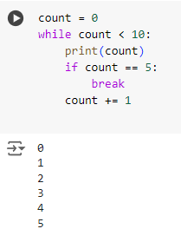
While Loops
Examples
While Loop with Break Statement
The loop prints numbers from 0 to 5. When count equals 5, the break statement stops the loop.

Slide 14
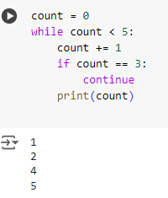
While Loops
Examples
While Loop with Continue Statement
This loop increments count by 1 in each iteration. When count is 3, continue skips printing and goes back to the loop.

Slide 15
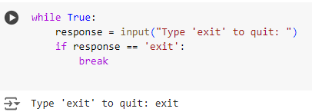
While Loops
Examples
Infinite While Loop with a Break
This loop runs indefinitely until the user types "exit". When "exit" is typed, the break statement ends the loop.

Slide 16
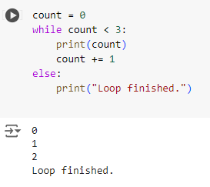
While Loops
Examples
While Loop with an Else Clause
The loop prints numbers from 0 to 2. When count reaches 3, the loop ends, and the else clause executes.

Slide 17
Summary
For Loops: Ideal for iterating over a known sequence, such as lists, strings, or ranges. They provide a straightforward way to execute a block of code multiple times.
While Loops: Useful when the number of iterations is not predetermined. They continue to execute as long as a condition remains true.
Break and Continue: break exits the loop immediately, while continue skips to the next iteration.
Else with Loops: Both for and while loops can have an else clause that executes when the loop completes naturally without hitting a break.

Slide 18
Large Practical Application

Slide 19
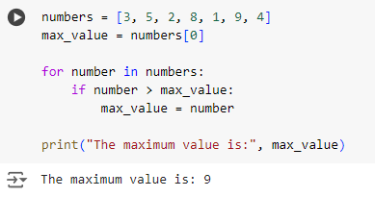
Finding the Maximum Value in a List
This for loop iterates over the numbers list to find the maximum value. It initializes max_value with the first element and updates it whenever it finds a larger number.

Slide 20
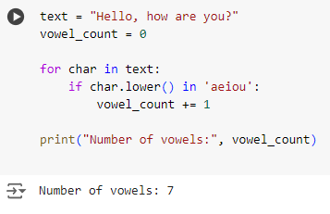
Counting Vowels in a String
This for loop goes through each character in the string text and checks if it is a vowel. It increments the vowel_count for each vowel found.

Slide 21
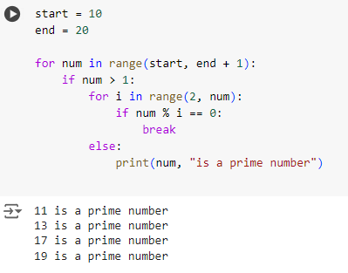
Finding Prime Numbers within a Range
The outer for loop iterates over numbers from start to end. The inner for loop checks if a number is divisible by any number other than 1 and itself. If it is, the break statement is executed, skipping to the next number.

Slide 22
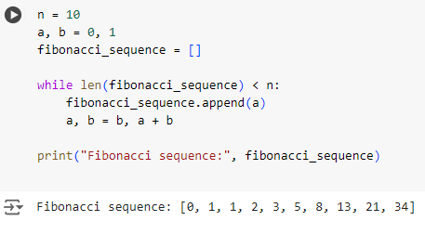
Generating a Fibonacci Sequence
This while loop generates a Fibonacci sequence of length n. It appends each new term to the fibonacci_sequence list until it reaches the desired length.

Slide 23
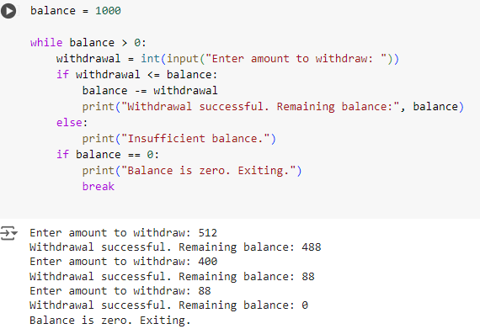
Simulating a Basic ATM Withdrawal
This while loop simulates an ATM withdrawal process. It checks if the withdrawal amount is less than or equal to the balance and updates the balance accordingly. If the balance reaches zero, it exits.

Slide 24
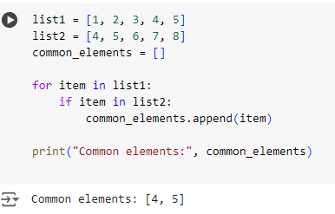
Finding Common Elements in Two Lists
This for loop checks each element in list1 to see if it exists in list2. If it does, the element is added to the common_elements list.

Slide 25
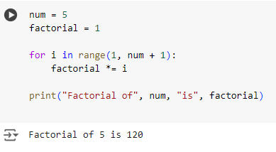
Calculating Factorial of a Number
This for loop calculates the factorial of a given number (num). It multiplies each integer from 1 to num to compute the factorial.

Slide 26
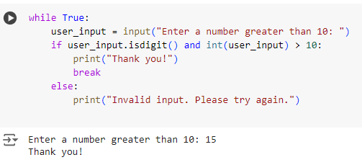
Validating User Input with While Loop
This while loop repeatedly asks the user for input until they enter a number greater than 10. The break statement exits the loop when valid input is provided.

Slide 27
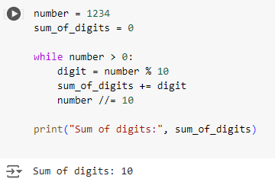
Finding the Sum of Digits of a Number
This while loop calculates the sum of the digits of a given number. It extracts each digit using the modulus operator and adds it to sum_of_digits.

Slide 28
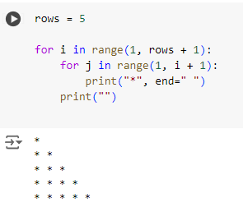
Drawing a Simple Pattern Using Loops
This nested for loop prints a simple right-angled triangle pattern using asterisks. The outer loop controls the number of rows, while the inner loop prints the stars.

Slide 29
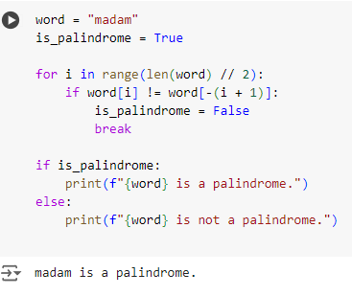
Checking for Palindrome Strings
This for loop checks if a string is a palindrome by comparing characters from the beginning and end moving towards the center. If any mismatch is found, it sets is_palindrome to False and breaks out of the loop.

Slide 30
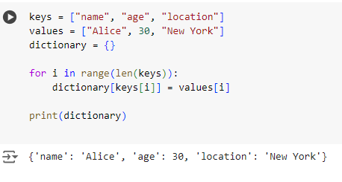
Creating a Dictionary from Two Lists
This for loop iterates over the indices of the keys list and creates a dictionary by associating each key with the corresponding value from the values list.

Slide 31
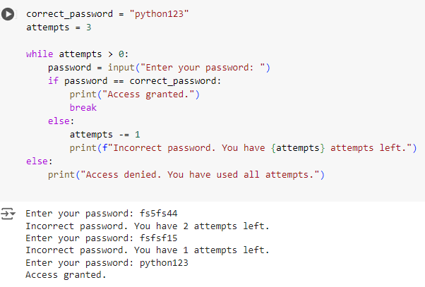
Simulating a Simple Password Check
This while loop simulates a password check, allowing the user up to three attempts to enter the correct password. If the correct password is entered, the loop breaks. Otherwise, it decrements the attempts and continues.

Slide 32
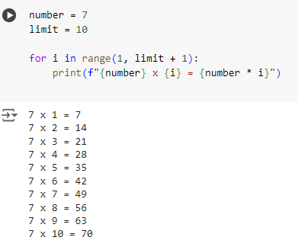
Generating a Multiplication Table for a Given Number
This for loop generates a multiplication table for the number (7 in this case) up to the specified limit (10). It multiplies the number by each value from 1 to limit and prints the result.

